Slide 1
SECURE DATA HIDING IN IMAGES USING STEGANOGRAPHY
CAPSTONE PROJECT
Presented By: Polipalli Mohan Krishna
Student Name : Polipalli Mohan Krishna
College Name & Department : Prasad V . Potluri Siddhartha institute of Technology Vijayawada (EEE) Department

Slide 2
OUTLINE
Problem Statement
Technology used
Wow factor
End users
Result
Conclusion
Git-hub Link
Future scope

Slide 3
Problem Statement
The problem involves securely concealing sensitive data within digital images using steganography, ensuring the hidden information is undetectable and resistant to unauthorized extraction. The challenge lies in maintaining image quality, achieving high embedding capacity, and providing robust encryption to prevent data breaches or detection by steganalysis techniques.

Slide 4
Technology used
python IDLE (3.13), pip install opencv-python CV2 Library, OS library , string library

Slide 5
Wow factors
1.Invisibility
2.High Security
3.Large embedding capacity
4.Real time application

Slide 6
End users
The end users of secure data hiding in images using steganography include: intelligence agencies, military personnel, law enforcement, journalists, businesses with sensitive information to protect, individuals seeking privacy, and ethical hackers and banking sectors etc.

Slide 7
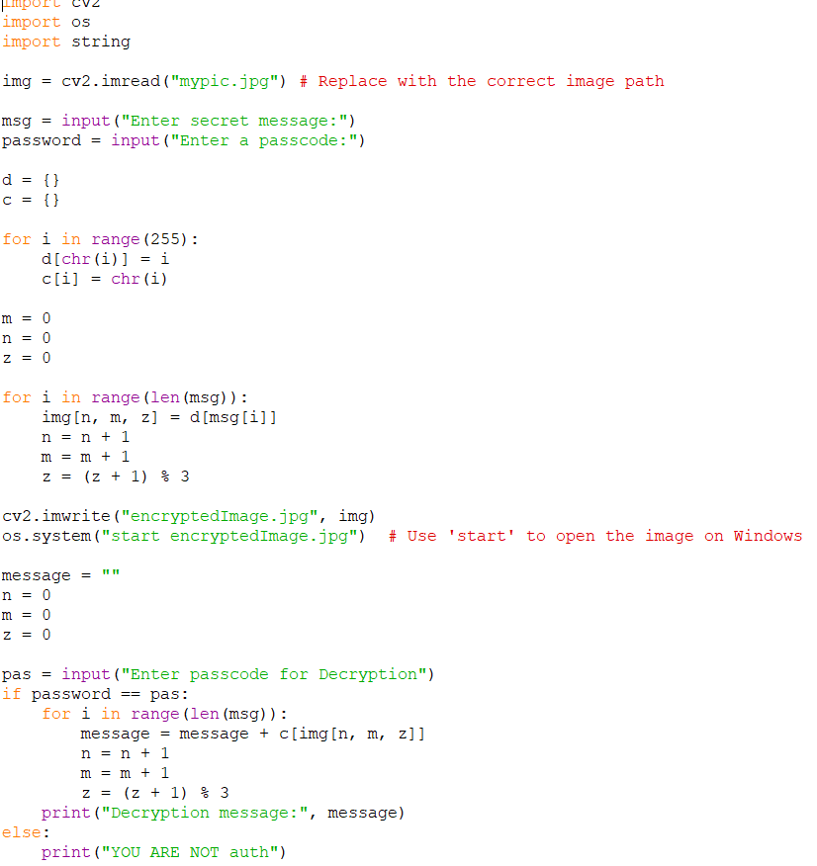
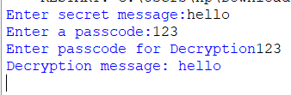
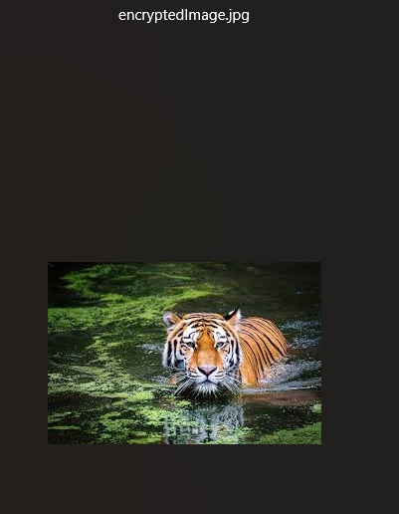
Results

Slide 8
Conclusion
In conclusion, secure data hiding in images using steganography offers a powerful and innovative solution for covert communication and data protection. By combining advanced steganographic techniques with robust encryption, it ensures the confidentiality, integrity, and undetectability of hidden information. The ability to maintain image quality, resist steganalysis, and support high embedding capacity makes it a versatile tool for applications in cybersecurity, military, healthcare, and digital watermarking. This technology stands out as a reliable and efficient method for safeguarding sensitive data in an increasingly digital world.

Slide 9
GitHub Link
https://github.com/Polipallimohan/Steganography.git

Slide 10
Future scope(optional)

Slide 11
THANK YOU

